Slide 1


Intelligence Analysis: Top-Down Part 1
John Beverley
Assistant Professor, University at Buffalo
Co-Director, National Center for Ontological Research
Affiliate Faculty, Institute of Artificial Intelligence and Data Science

Slide 2
Outline
Big Data and the Intelligence Cycle
Ontology Engineering

Slide 3
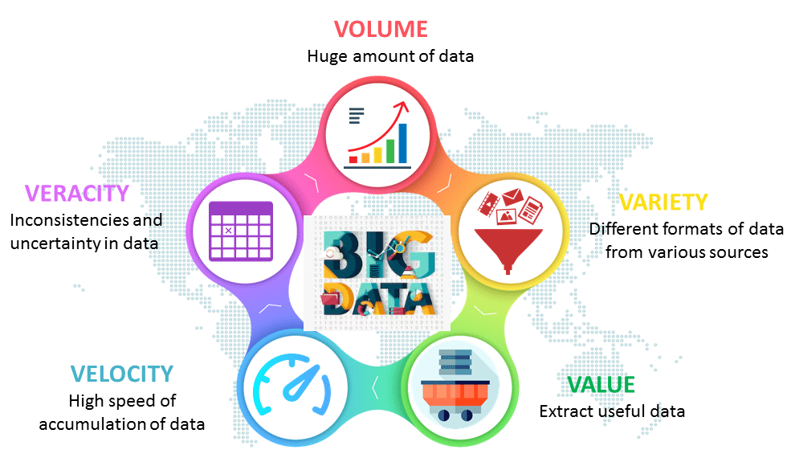
Big Data Big Problems

Slide 4
Big Data Big Problems
As of 2022, over 147
Zettabytes of data
had been stored

Slide 5
Zettabytes
Let’s put this in perspective...
A 50 Megabyte connection will allow you to comfortably stream 4K videos
At 50 Megabytes per second, it would take you 634,196 years to stream 1 Zettabyte of data
For 147 Zettabytes, it would take 93,226,788 years

Slide 6
Big Data Big Problems
The volume of data generated grows
exponentially each year; as of 2020
.4 Zettabytes bytes per day

Slide 7
Big Data Big Problems
Some trustworthy, e.g. academic research
Some not trustworthy, e.g. twitter
Various standards, e.g. xml, ttl, jsonld, etc.

Slide 8
Big Data Big Problems
Conflicts invariably emerge, often between
less than trustworthy sources, but also
between trusted sources

Slide 9
Big Data Big Problems
Extracting useful information generated at such a fast clip, is challenging

Slide 10
Intelligence Cycle
A systematic process used by intelligence agencies or agencies engaged in intelligence activities that outlines stages through which raw data is transformed into intelligence
Leveraging the intelligence cycle at least partially addresses some aspects of issues arising from Big Data

Slide 11





Epistemic Communities
Intelligence analysis is often conducted within an epistemic community
Such communities often share:
Normative beliefs about the purpose of their actions
Beliefs based on experiences from investigating central problems in their domain
Standards of accuracy for analyses in their field of expertise
Common community goals

Slide 12
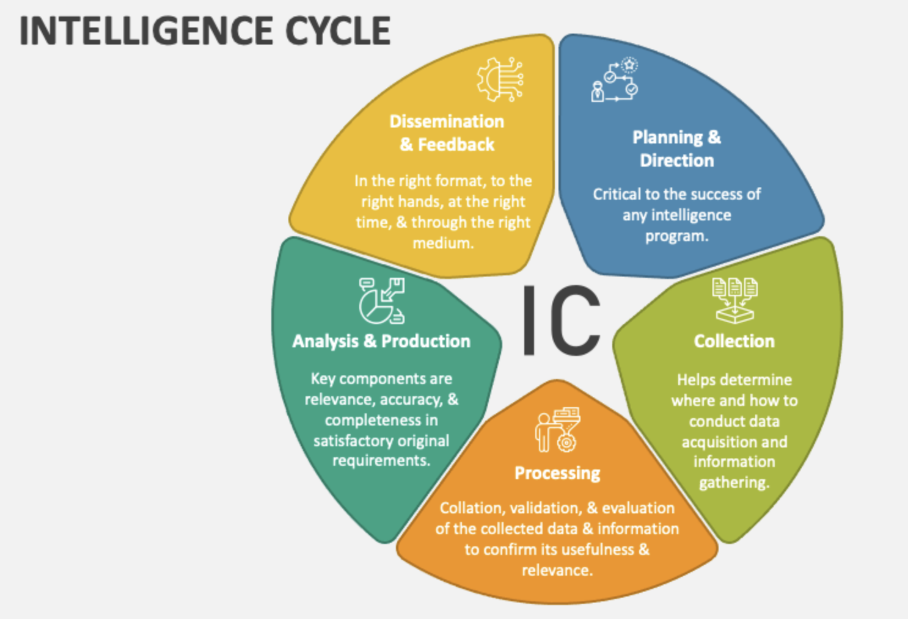
Decision-makers define objectives and set priorities for what needs to be known, thereby providing standards against which data can be judged as valuable or not
VALUE

Slide 13
Involves standards for acquiring large amounts of data from diverse sources at high speeds, in different formats, e.g. structured, unstructured, multimedia, etc.
VOLUME
VARIETY

Slide 14
Involves converting raw data into usable formats, evaluating data for relevance, removing irrelevant data, and cleaning remaining data to improve quality
VARIETY
VERACITY

Slide 15
Produces actionable intelligence by evaluating data for accuracy and validity, e.g. comparing satellite images to ground reports to verify troop movements
VALUE
VERACITY

Slide 16
Promotes timely delivering of intelligence to decision-makers; with the cycle ultimately acting as a filter to extract something valuable from the massive flood of incoming data
VELOCITY
VALUE

Slide 17

Intelligence Analysis Solutions?

Slide 18

Not So Fast...

Slide 19

Information Silos
An information silo is an information repository, e.g. management system, database, the content of which cannot be integrated with that of other information repositories using computing strategies
Information silos may manifest in an organization for a variety of reasons:

Slide 20
Information Silos
An information silo is an information repository, e.g. management system, database, the content of which cannot be integrated with that of other information repositories using computing strategies
Information silos may manifest in an organization for a variety of reasons:
Ignorance – Do not realize a given information repository exists

Slide 21
Information Silos
An information silo is an information repository, e.g. management system, database, the content of which cannot be integrated with that of other information repositories using computing strategies
Information silos may manifest in an organization for a variety of reasons:
Ignorance – Do not realize a given information repository exists
Inaccessible – Do not have the appropriate permissions to access

Slide 22
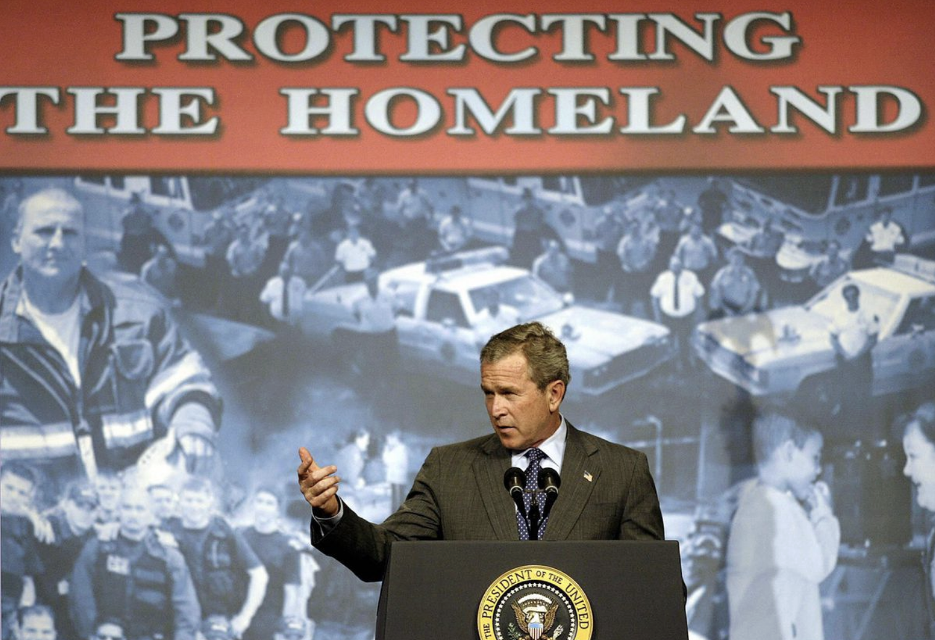
9/11
Resulting investigations revealed U.S. intelligence agencies knew Al-Queda was mobilizing, but information was not shared freely across agencies
At the time the NSA considered itself an intelligence curator; if an agency asked whether Al-Queda was mobilizing, they’d confirm
Few people knew to ask...

Slide 23
Information Silos
An information silo is an information repository, e.g. management system, database, the content of which cannot be integrated with that of other information repositories using computing strategies
Information silos may manifest in an organization for a variety of reasons:
Ignorance – Do not realize a given information repository exists
Inaccessible – Do not have the appropriate permissions to access
Infeasible – Do not have the appropriate technology to access

Slide 24
Information Silos
An information silo is an information repository, e.g. management system, database, the content of which cannot be integrated with that of other information repositories using computing strategies
Information silos may manifest in an organization for a variety of reasons:
Ignorance – Do not realize a given information repository exists
Inaccessible – Do not have the appropriate permissions to access
Infeasible – Do not have the appropriate technology to access
MORE AND MORE AGENCIES ARE FINDING THEMSELVES HERE

Slide 25
Information Silos
An information silo is an information repository, e.g. management system, database, the content of which cannot be integrated with that of other information repositories using computing strategies
Information silos may manifest in an organization for a variety of reasons:
Ignorance – Do not realize a given information repository exists
Inaccessible – Do not have the appropriate permissions to access
Infeasible – Do not have the appropriate technology to access
Insane – Do not care about integrating with other repositories

Slide 26
Cost of Silos
A 2020 report by NIST estimated the lack of interoperability across industrial datasets costs companies between 21-43 billion
McKinsey estimates mid-size companies spend 20-50 million annually due to silos

Slide 27
Interoperability
Vetting, filtering, processing, etc. address – to some extent – big data problems
But the challenge of information siloes threatens to undermine virtues of the intelligence cycle...
Unfortunately, information silos seem rather common among intelligence organizations and agencies that depend on them...

Slide 28
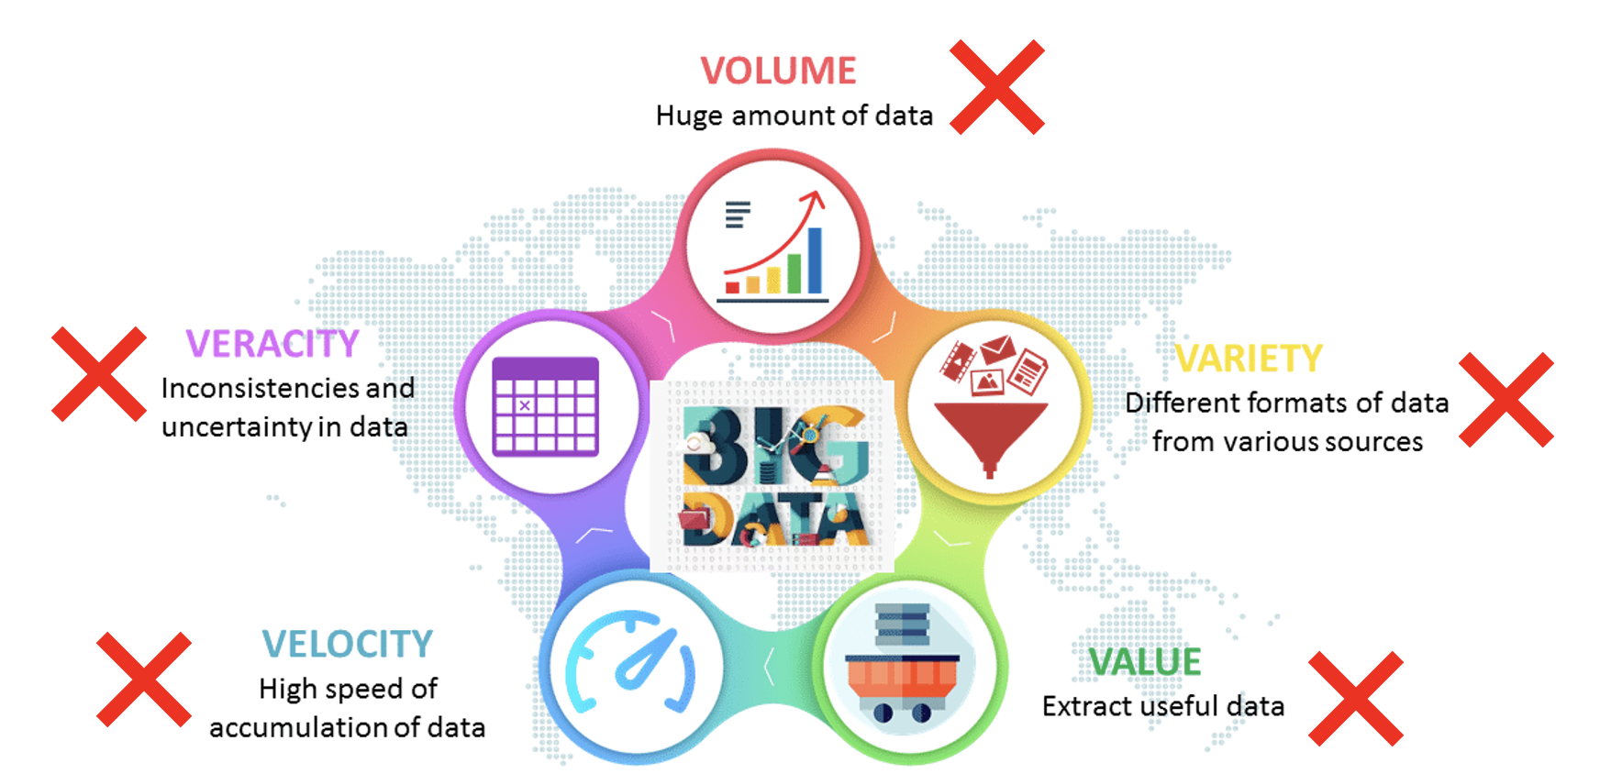
Information Silos & the Intelligence Cycle
Silos:
Result in data fragmentation and redundancy; undermine consolidation VOLUME
Create bottlenecks that delay information dissemination VELOCITY
House data in formats incompatible with those of other silos VARIETY
Leverage inconsistent standards and undermined cross-data validation VERACITY
Hinder value obtained by integrating diverse data VALUE

Slide 29
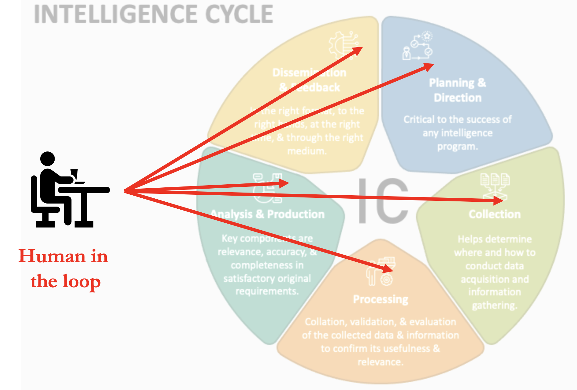
Interoperability
Information silos are particularly problematic for intelligence; if left unaddressed, integrating disparate data will continue to fall on the shoulders of humans
Fortunately, there are long-standing strategies for addressing such interoperability challenges

Slide 30
Outline
Big Data and the Intelligence Cycle
Ontology Engineering

Slide 31
Outline
Big Data and the Intelligence Cycle
Ontology Engineering

Slide 32
Promise of Ontology Engineering
Ontologies are formally well-defined machine-interpretable controlled vocabularies designed to represent entities and logical relationships among them
Ontologies make explicit the implicit meanings buried in datasets, by using basic principles of formal logic
Ontologies provide a semantic layer to connect information silos
Notes:
Promote the reuse of domain knowledge from other ontologies, through a common formal language: OWL
Internationalized Resource Identifiers (IRIs) promote tracking of entities and cross-ontology references, support interoperability
Promote human-human, human-computer, and computer-computer communication
Enable automated inference useful for deriving implicit information, as they effectively connect parts of taxonomies to other parts of taxonomies in machine-readable ways

Slide 33
Promise of Ontology Engineering
Provide a lingua franca across silos, reducing fragmentation/redundancy VOLUME
Promote automated data integration, standardizes querying, mapping VELOCITY
Exhibiting standardized syntax/semantics in common format/standards VARIETY
Representations leverage textual/logical definitions, consistency check, VERACITY
Facilitate information extraction across disparate data, broad integration VALUE
Notes:
Promote the reuse of domain knowledge from other ontologies, through a common formal language: OWL
Internationalized Resource Identifiers (IRIs) promote tracking of entities and cross-ontology references, support interoperability
Promote human-human, human-computer, and computer-computer communication
Enable automated inference useful for deriving implicit information, as they effectively connect parts of taxonomies to other parts of taxonomies in machine-readable ways

Slide 34

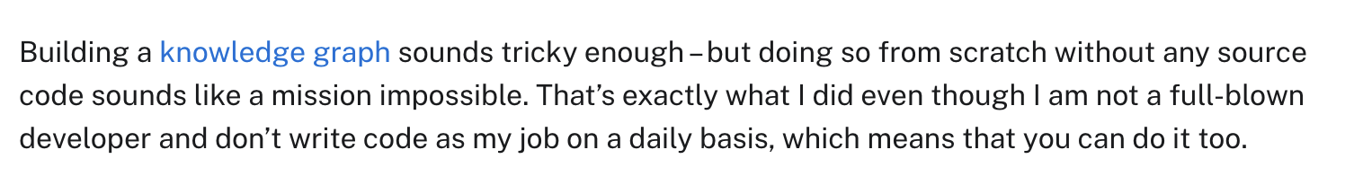

Slide 35
*
*A knowledge graph is just an ontology applied to data

Slide 36
just another information silo
In any event, don’t be fooled by the hype...

Slide 37
Ontology Engineering is Easy!
Constructing an ontology can be easy ... just write some python to read a file and generate classes/relations from column headers
Constructing an ontology according to a standard is more challenging
But that is how we avoid information silos

Slide 38
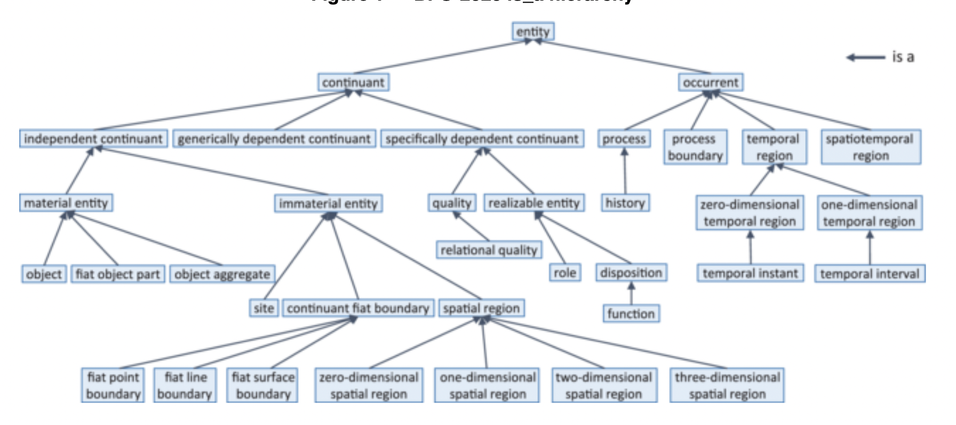
Basic Formal Ontology
BFO is such a standard, used by over 700 open-source groups, the first ISO/IEC top-level ontology standard, and a “baseline standard” for DOD-IC ontology development

Slide 39
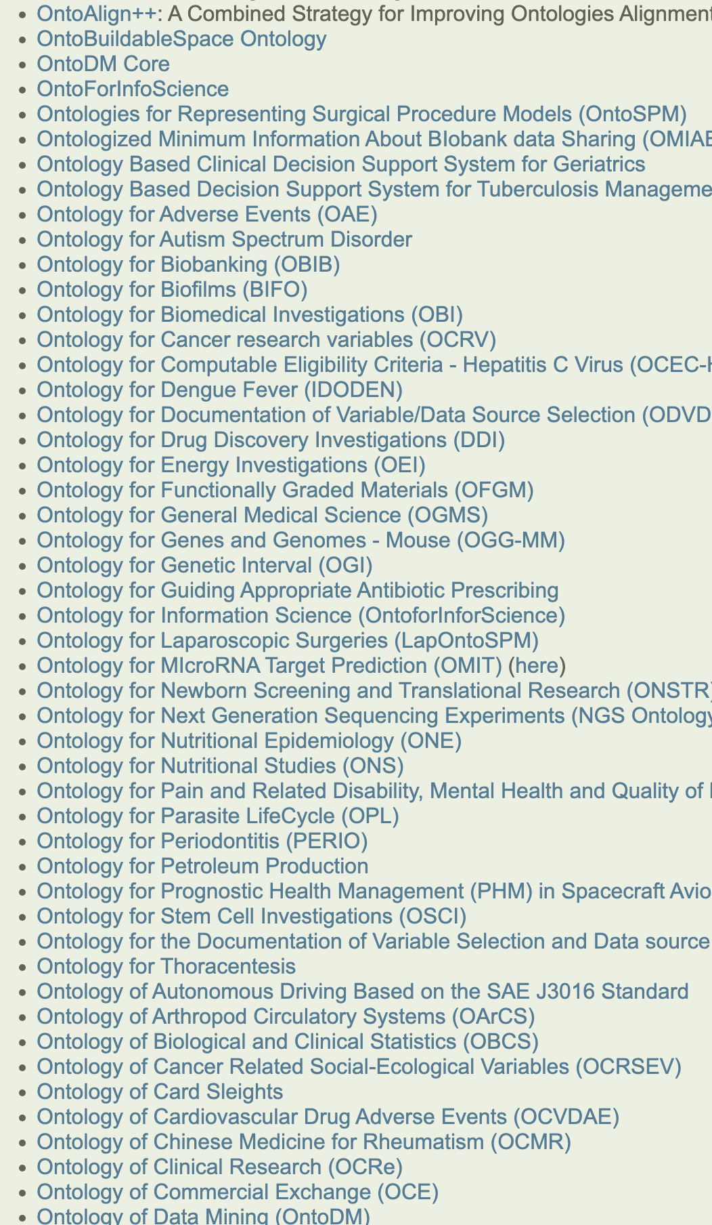
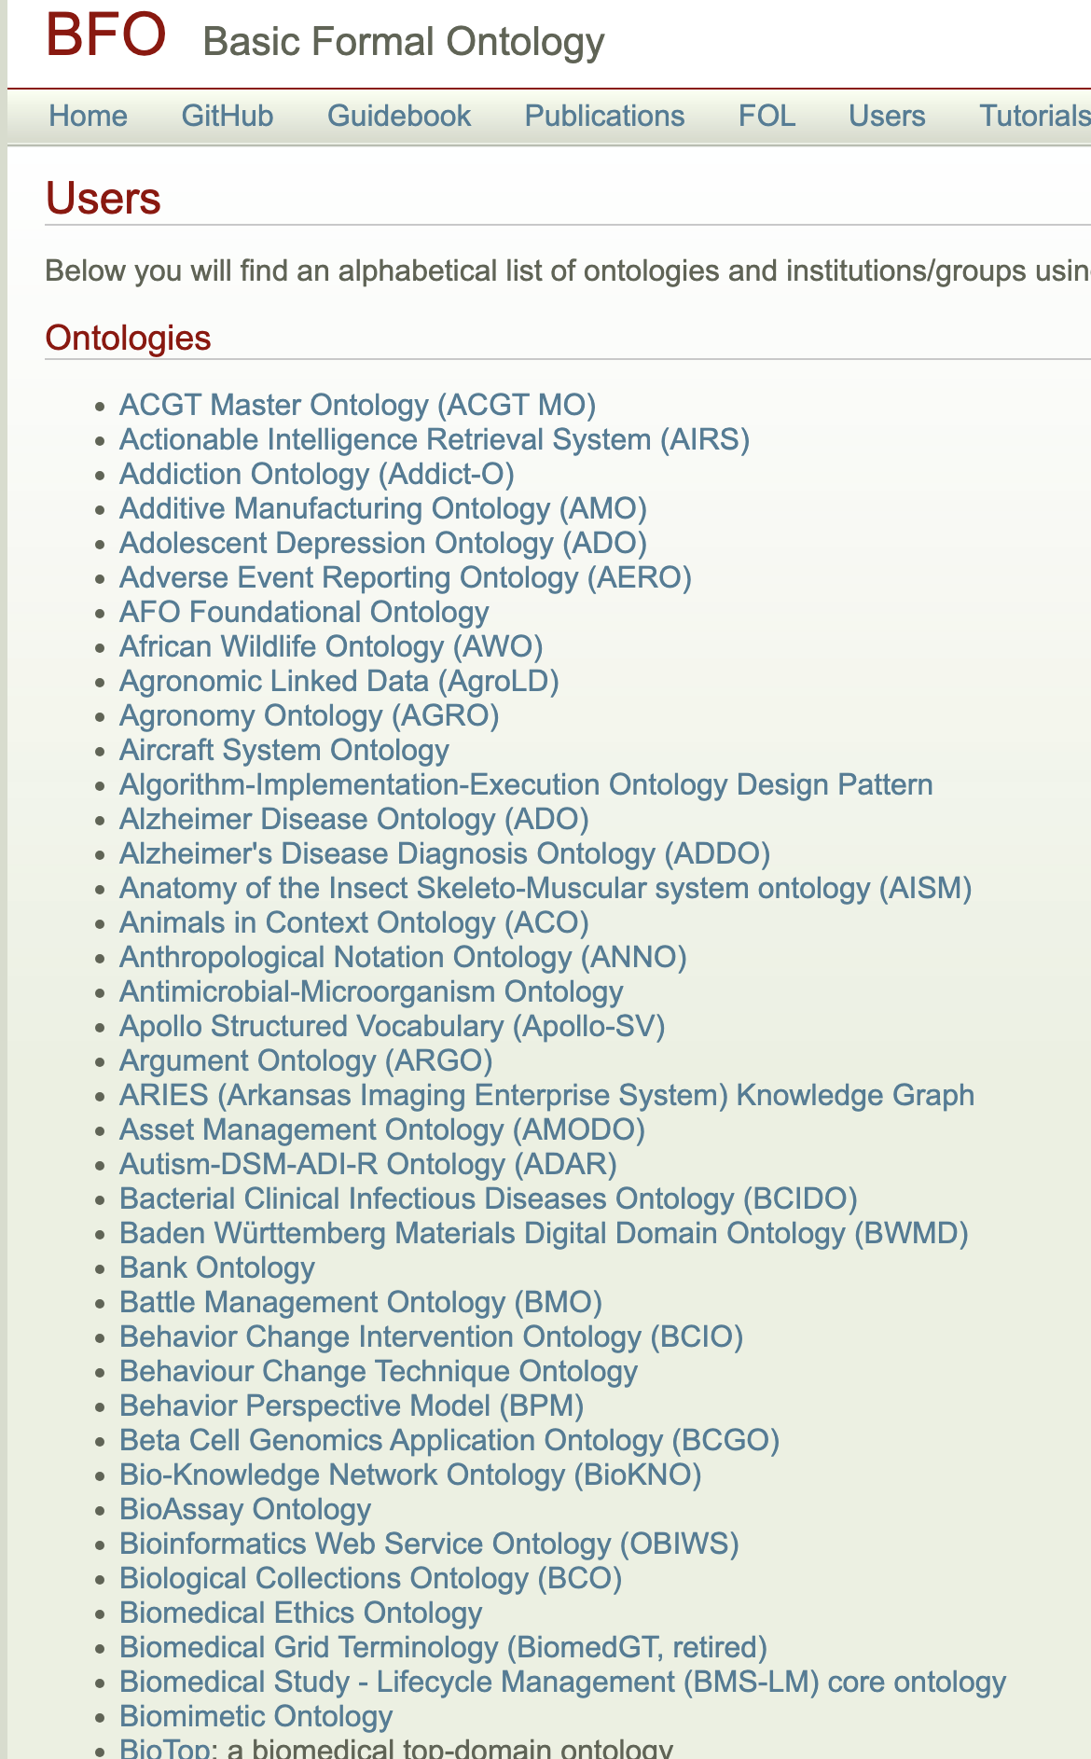
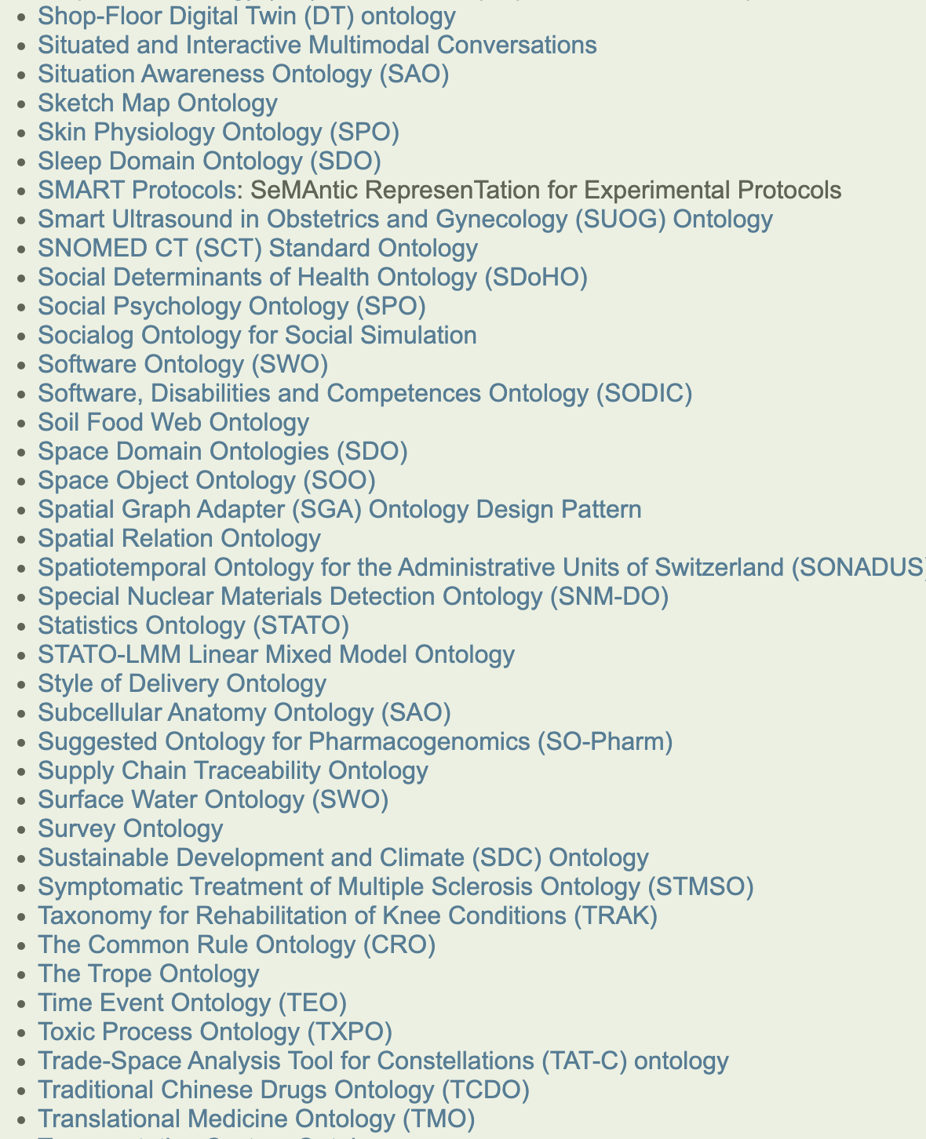
BFO Ecosystem
700+ Projects

Slide 40
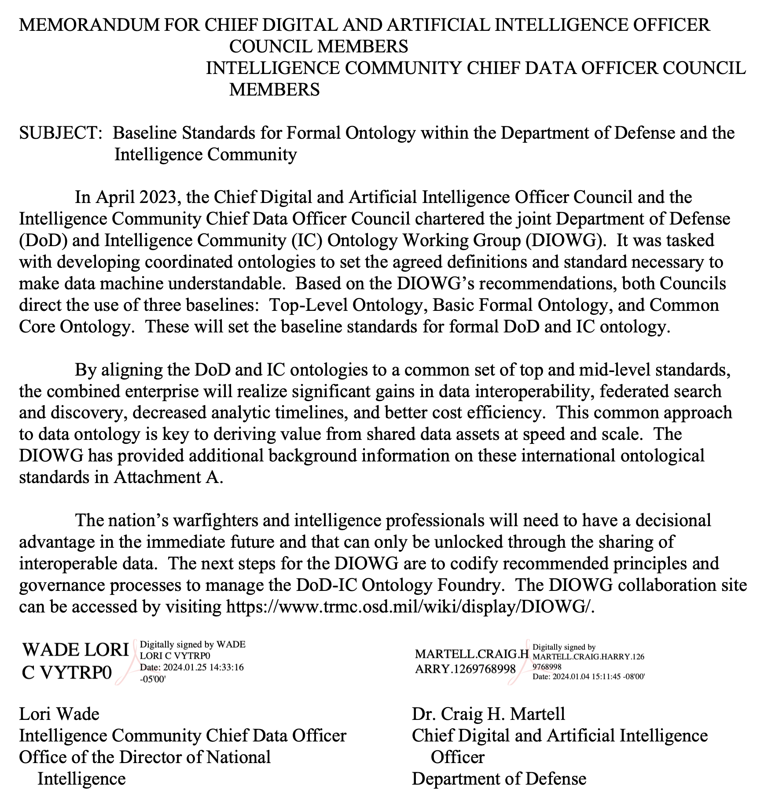
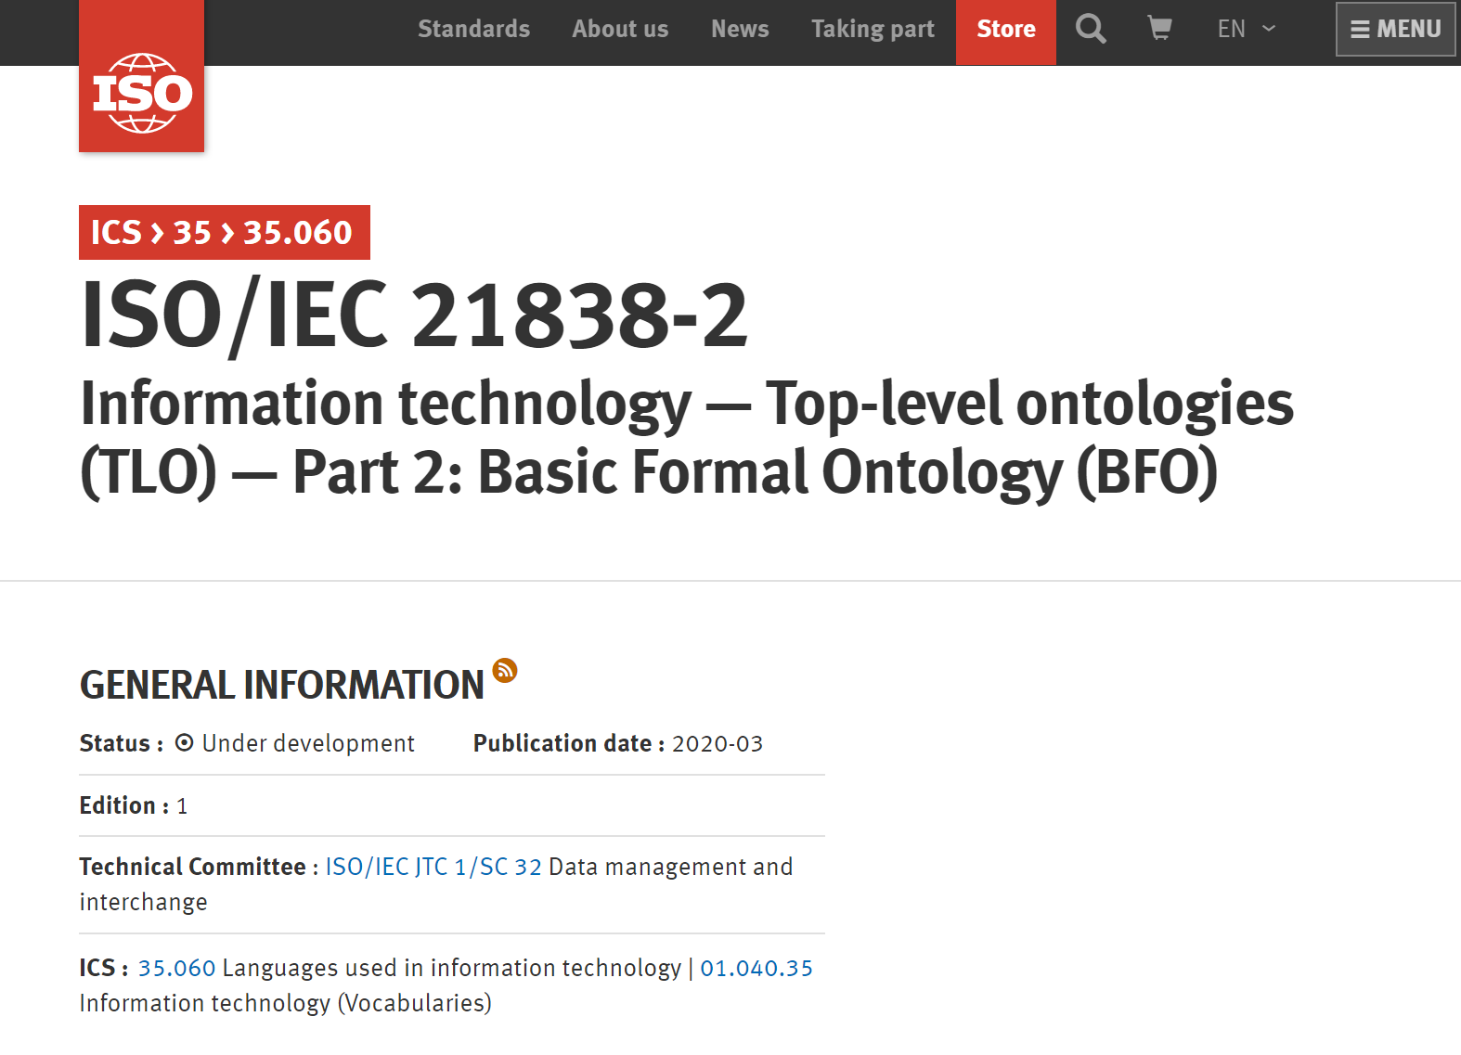

Slide 41
Classes represent collections of instances For example: the class of tables falls under the class of objects and your dinner table would be an instance of the former
Class A is_a Class B means any instance of Class A is an instance of Class B

Slide 42
Methodological Convictions
Realism – BFO is designed to represent the world, rather than simply concepts about the world
Adequatism – BFO is non-reductive, classes and relations motivated by research communities are not ‘paraphrased away’ for example
Fallibilism – BFO is committed to tracking scientific research over time, which might change

Slide 43
Methodological Convictions
Realism – BFO is designed to represent the world, rather than simply concepts about the world
Adequatism – BFO is non-reductive, classes and relations motivated by research communities are not ‘paraphrased away’ for example
Fallibilism – BFO is committed to tracking scientific research over time, which might change

Slide 44
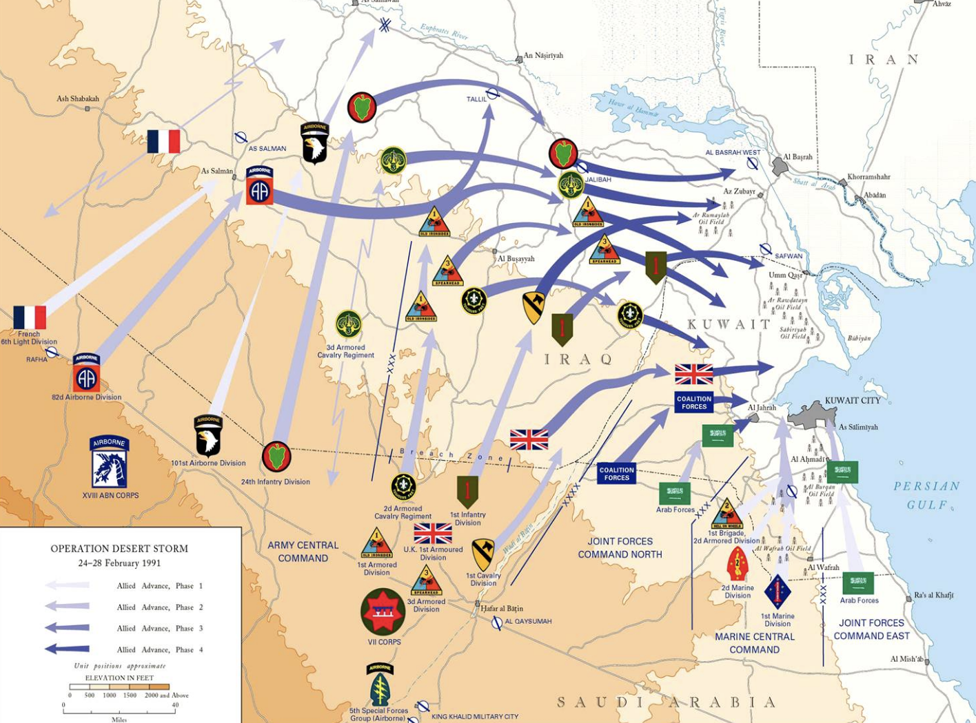

Directions of Fit for Ontology Engineering
Ontology engineering strategies can be distinguished by direction of fit
World-to-Word: Make world fit the words
Word-to-World: Make words fit the world

Slide 45
Direction of Fit
World-to-Word: Make world fit the words
Word-to-World: Make words fit the world
Suppose you’re a spy watching someone shop in a grocery store. They have a shopping list and are checking items off as they put them in their basket.
You are recording their behavior

Slide 46
Direction of Fit
World-to-Word: Make world fit the words
Word-to-World: Make words fit the world
Suppose he buys butter when the list directed purchasing margarine
Correcting this mistake would involve him buying butter
Rather than changing the list to read “margarine”

Slide 47
Direction of Fit
World-to-Word: Make world fit the words
Word-to-World: Make words fit the world
Suppose you record that he bought butter when he bought margarine
Correcting this mistake would involve you updating your record
Rather than getting him to buy butter

Slide 48
Directions of Fit for Ontology Engineering
Ontology engineering strategies can be distinguished by direction of fit
World-to-Word: Make world fit the words, e.g. conceptualism
Word-to-World: Make words fit the world, e.g. realism

Slide 49
Conceptualism
“An ontology is a specification of a conceptualization” –Gruber, 1992
Interpreted as claiming that ontologies represent concepts
“Taking a more pragmatic view, one can say that ontology is a tool and product of engineering and thereby defined by its use.” –Gruber, 2009
Interpreted as claiming ontologies represent what they need to represent

Slide 50

Realism
Ontologies are a specification of the world
If we attempt to go from the words we use to the world, it is unlikely that we will end up in the same place
If we attempt to go from the world to the words we use, it is more likely we will remain coordinated

Slide 51
Methodological Convictions
Realism – BFO is designed to represent the world, rather than simply concepts about the world
Adequatism – BFO is non-reductive, classes and relations motivated by research communities are not ‘paraphrased away’ for example
Fallibilism – BFO is committed to tracking scientific research over time, which might change

Slide 52

Barry Smith instance_of Agent
Material Entity
Object
CLASSES
Agent
INSTANCES

Slide 53

SUNY Professor instance_of Professor Role
Material Entity
Realizable Entity
Object
Role
CLASSES
Agent
Professor Role
INSTANCES

Slide 54
Barry Smith bearer_of SUNY Professor
Material Entity
Realizable Entity
Object
Role
CLASSES
Agent
Professor Role
INSTANCES

Slide 55
Methodological Convictions
Realism – BFO is designed to represent the world, rather than simply concepts about the world
Adequatism – BFO is non-reductive, classes and relations motivated by research communities are not ‘paraphrased away’ for example
Fallibilism – BFO is committed to tracking scientific research over time, which might change

Slide 56
Using BFO as a top-level architecture, ontologies covering more specific content, e.g. livers, food, computers, etc. can extend be easily extended from it

Slide 57
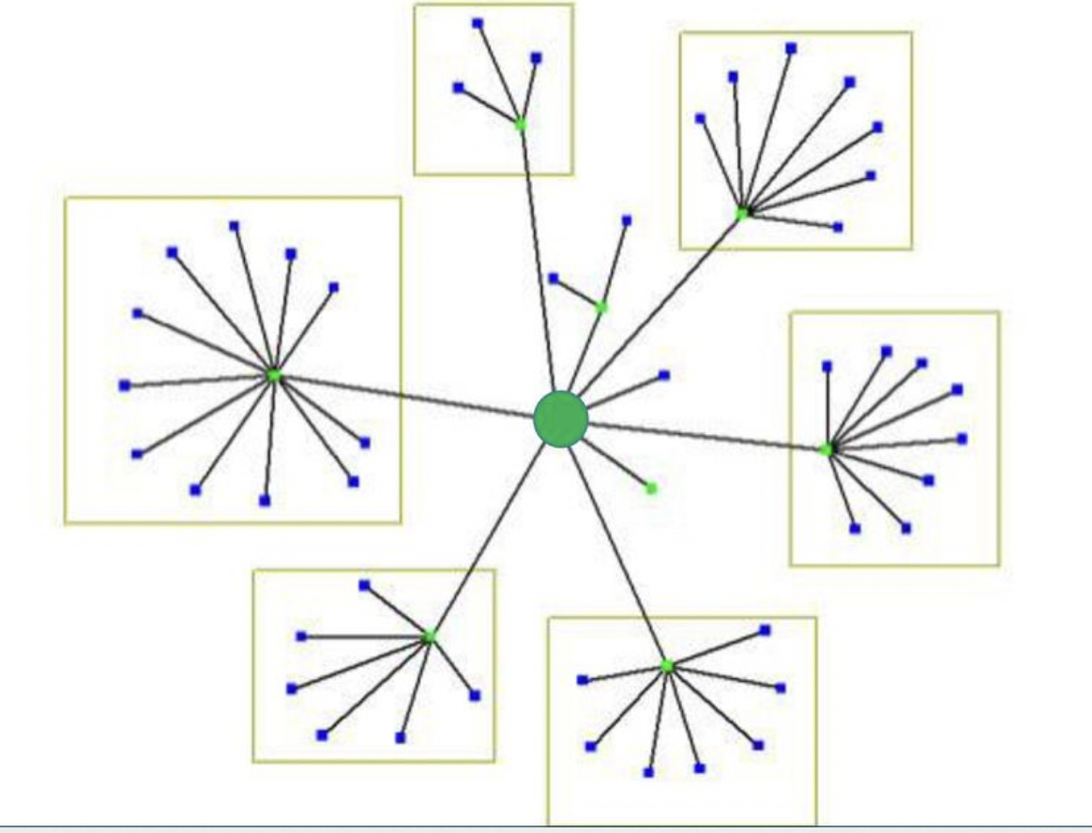
Hub & Spoke Strategy
Ontologies extending from BFO are modules in a larger hub & spoke structure
Ontologies are extended by downward population, new classes have parent classes in a hierarchy ultimately leading to a BFO class
BFO

Slide 58
Hub & Spoke Strategy
Provides guardrails for promoting alignment between ontologies representing nearby domains
Progress towards interoperability is ensured upfront, since spokes share semantics with the same hub
BFO

Slide 59
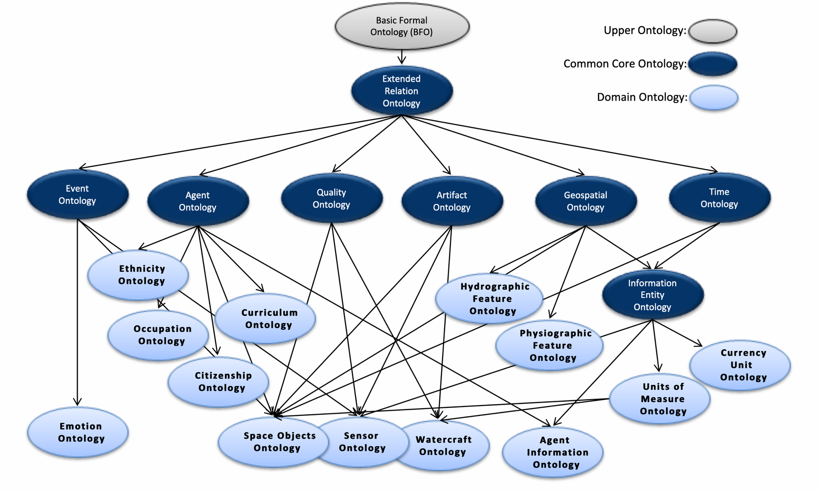
The Common Core Ontologies and Domain Extensions

Slide 60
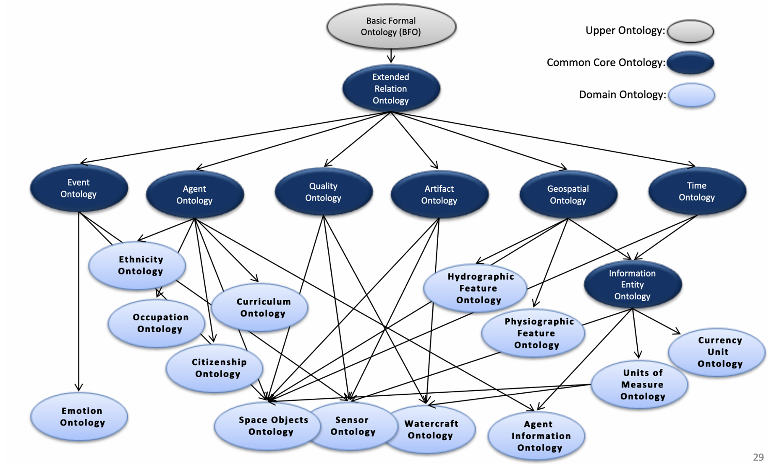

Python Analogy
BFO is analogous to the Python programming language; extensions of BFO – such as CCO - are analogous to Python libraries
You could create code that allows you to interact with, say, dataframes or you could instead start with Python and import a library like Pandas
You could create ontology elements that allow you to model artifacts and processes or you could instead start with BFO and import a library like CCO

Slide 61
The Common Core Ontologies and Domain Extensions

Slide 62
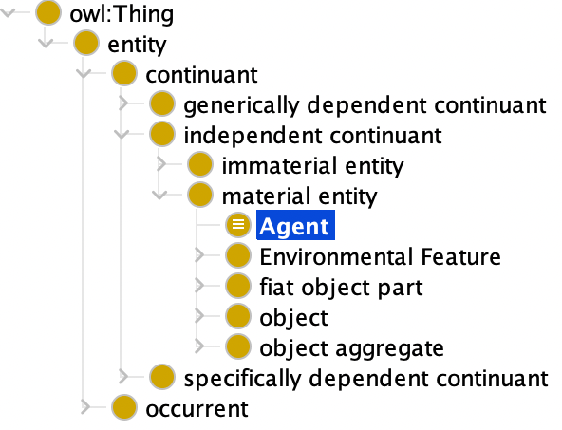
Hub & Spoke Strategy
BFO

Slide 63
Hub & Spoke Strategy
BFO

Slide 64
Definition Construction Strategy
Material Entity (Elucidation) – An independent continuant that has some portion of matter as part
Agent (Definition) - A material entity that is capable of performing intentional acts
Definitions of ontology elements are created following a recipe, to ensure the hub semantics are preserved by spokes, and minimize human error

Slide 65
Definition Construction Strategy
Material Entity (Elucidation) – An independent continuant that has some portion of matter as part
Agent (Definition) - A material entity that is capable of performing intentional acts
Downward population leverages the definition scheme:
A is a B that Cs
Where B is the parent class under which A falls

Slide 66
Definition Construction Strategy
Material Entity (Elucidation) – An independent continuant that has some portion of matter as part
Agent (Definition) - A material entity that is capable of performing intentional acts
Downward population leverages the definition scheme:
A is a B that Cs
Where B is the parent class under which A falls

Slide 67
Definition Construction Strategy
Material Entity (Elucidation) – An independent continuant that has some portion of matter as part
Agent (Definition) - A material entity that is capable of performing intentional acts
Downward population leverages the definition scheme:
A is a B that Cs
Where B is the parent class under which A falls

Slide 68
Definition Construction Strategy
Material Entity (Elucidation) – An independent continuant that has some portion of matter as part
Agent (Definition) - A material entity that is capable of performing intentional acts
Downward population leverages the definition scheme:
A is a B that Cs
Where B is the parent class under which A falls

Slide 69
Interoperability Guardrails
The hub & spoke strategy provides a guardrails for promoting alignment between ontologies representing nearby and overlapping domains
By following the recipe, progress towards interoperability is ensured upfront, since elements inherited from the hub ontologies overlap semantically
By not following such a strategy you get...information silos...

Slide 70






Slide 71

NO TOP-LEVEL
TOP-LEVEL
SILO

Slide 72
Scope Creep
The hub & spoke strategy significantly cuts down on scope creep, which arises when an ontology is created as an information silo, but over time grows beyond its initial scope
If the ontology does not extend from a higher-level ontology, it will likely not be compatible with other ontologies
Developers will then need to recreate existing work because it is not interoperable with their ontology...

Slide 73
SCOPE CREEP

